Slide 1
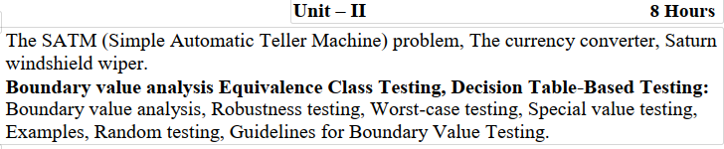
Unit-2

Slide 2
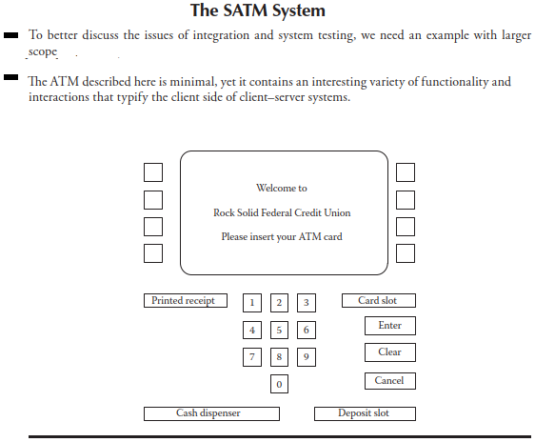

Slide 3
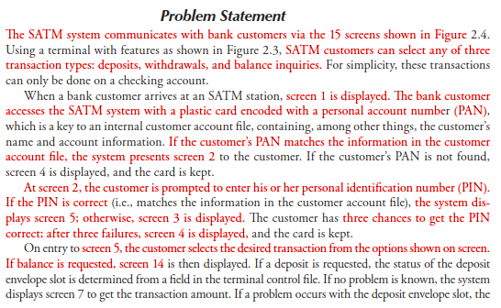

Slide 4
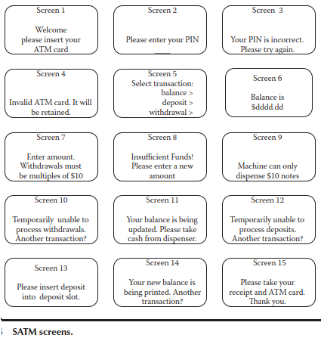

Slide 5
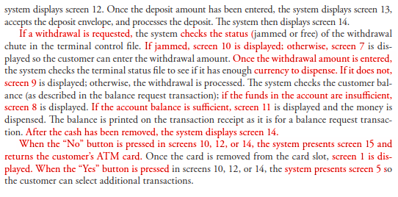

Slide 6
Need for Boundary:
Any program can be considered to be a function in the sense that program inputs form its domain and program outputs form its range.
We examine how to use knowledge of the functional nature of a program to identify test cases for the program.
Input domain testing (also called “boundary value testing”) is the best-known specification-based testing technique.
It is often a good supplement to develop range based test cases.

Slide 7
There are two independent considerations that apply to input domain testing.
1) The first asks whether or not we are concerned with invalid values of variables. Normal boundary value testing is concerned only with valid values of the input variables. Robust boundary value testing considers invalid and valid variable values.
2) The second consideration is whether we make the “single
fault” assumption common to reliability theory. This assumes that faults are due to incorrect values of a single variable. If this is not warranted, meaning that we are concerned with interaction among two or more variables, we need to take the cross product of the individual variables

Slide 8
Taken together, the two considerations yield four variations of boundary value testing:
◾ Normal boundary value testing
◾ Robust boundary value testing
◾ Worst-case boundary value testing
◾ Robust worst-case boundary value testing
For the sake of comprehensible drawings, the discussion refers to a function, F of two variables x1 and x2.
When the function F is implemented as a program, the input variables x1 and x2 will have some (possibly unstated) boundaries:
a ≤ x1 ≤ b
c ≤ x2 ≤ d

Slide 9
The intervals [a, b] and [c, d] are referred to as the ranges of x1 and x2, we have an overloaded term “Range”.
The intended meaning will always be clear from its context so as to understand the meaning of the word Range.
Boundary Value Testing is more appropriate for program’s input space (domain) of function F.
Any point within the shaded rectangle and including the boundaries is a legitimate input to the function F.
This is shown in following Figure, (This has the two input variables x1 & x2 for function F given at a time)

Slide 10
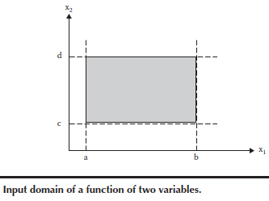

Slide 11
Normal Boundary Value testing
The basic idea of boundary value analysis is to use input variable values
At their minimum
Just above the minimum
A nominal value
Just below their maximum
At their maximum.

Slide 13
Generalizing Boundary Value Analysis
The basic boundary value analysis technique can be generalized in two ways:
By the number of variables
By the kinds of ranges.
How to generate test cases for Boundary Values Analysis is:
If we have a function of n variables, we hold all but one at the nominal values
Let the remaining variable assume the min, min+, nom, max–, and max values, repeating this for each variable.
Thus, for a function of n variables, boundary value analysis yields 4n + 1 unique test cases.

Slide 14
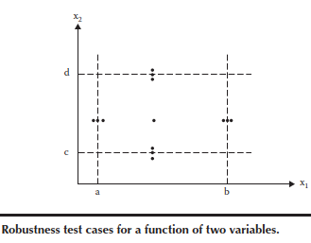
Robust Boundary Value testing
Robust boundary value testing is a simple extension of normal boundary value testing: in addition to the five boundary value analysis values of a variable,
what happens when the extreme are exceeded with a value slightly greater than the maximum (max+)
What happens a value slightly less than the minimum (min–). Robust boundary value test cases

Slide 15
Worst-Case Boundary Value testing
Both forms of boundary value testing, as said earlier, make the single fault assumption of reliability theory.
Rejecting single-fault assumption means that we are interested in what happens when more than one variable has an extreme value. This is called “worst-case analysis”
For each variable, we start with the five-element set that contains the min, min+, nom, max–, and max) values.
worst-case testing for a function of n variables generates 5^{n} test cases, as opposed to 4n + 1 test cases for boundary value analysis.
Probably the best application for worst-case testing is where physical variables have numerous interactions, and failure of the function is extremely costly.

Slide 16
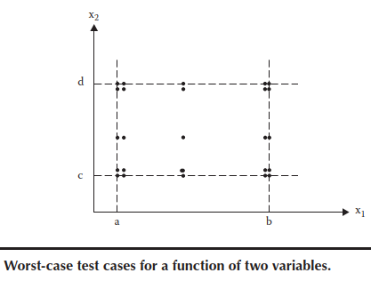

Slide 17
